Slide 1
An Interoffice Shipping Application
CS633 Software Quality, Testing and Security Management
Term Project Presentation
Group #6
Brian Calhoun
Alicia Gallagher
Steven Hoffman
Eunjou Kim
Carolina Torres

Slide 2

Project Information

Slide 3
Project Overview
ShipIT
Lightweight Interoffice Shipping Application
Developed In-House for BigCorp
Needed to Alleviate Existing Problems
Shippers Initiate the Process
Couriers Notified to Make Deliveries
Receivers Notified of Process

Slide 4
Meet the Team
Brian Calhoun
In Real Life
Air Force-Trained IT Specialist
Undergrad in Economics
Transitioning to Software Developer Role
Role: Senior Developer
Responsible For…
Architecture
Development & Defect Resolution
Components Interaction Diagram
Participated as Needed on All Deliverables

Slide 5
Meet the Team
Alicia Gallagher
In Real Life
DevOps Engineer at Software Company that provides Search Engine for Research
Graduating in Summer 2017 with MS in Computer Science from BU
Role: Usability Lead
Responsible For…
UX Design
Mockups and Wireframes
Participated as Needed on All Deliverables

Slide 6
Meet the Team
Steven Hoffman
In Real Life
Former Chemist, Received Bachelors From BU
Business Capability Manager in Pharma
This is My Last Class in the Program
Role: Team Lead
Responsible For…
CI List
State Transition Diagram
RASCI Chart
Meetings & Report
Participated as Needed on All Deliverables

Slide 7

Meet the Team
Eunjou (Karen) Kim
In Real Life
Web Application Developer at Automotive Company in Frankfurt, Geramany
Role: Test Expert
Responsible For…
Test Cases
Oversight of Test Execution & Results
Participated as Needed on All Deliverables

Slide 8
Meet the Team
Carolina Torres
In Real Life
Business Analyst
Undergrad in Industrial Engineering
Role: Business Analyst
Responsible For…
Persona Development
Requirements Elucidation
Use Case Development
Estimation Record
Participated as Needed on All Deliverables

Slide 9
Team Logistics & Tools
Standing Meetings on
Thursdays at 9PM EST
Sundays at 2 PM EST
Google Hangouts/Video Conferencing used for meetings.
Extensive use of e-mail.
Google Drive main document collaboration space.
Pivotal Tracker used for Requirements, Team Planning.
Wireframes Designed in Cacoo.
VS2015/C# used for Development.
GitHub used for code/document versioning.

Slide 10
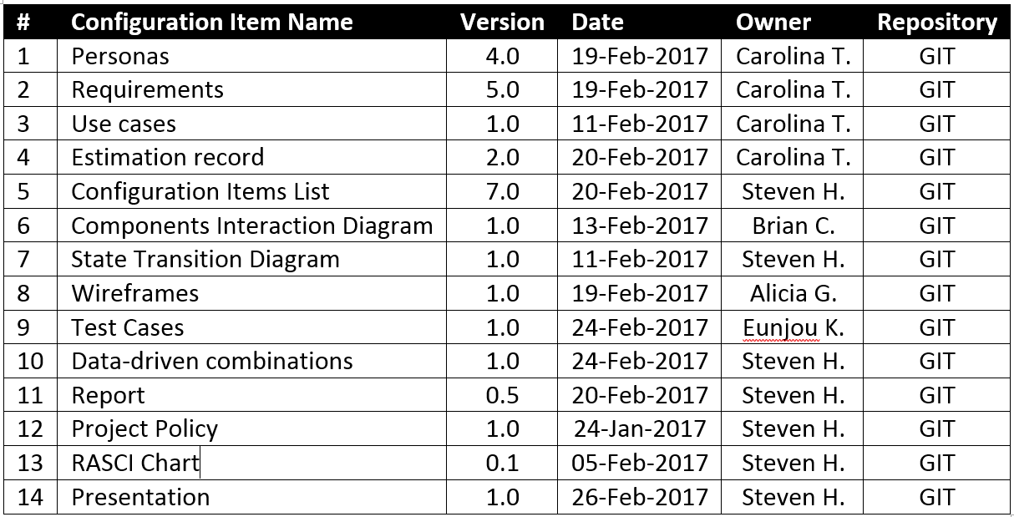
Configuration Item List
Created in various tools.
Reviewed in:
Drive
E-Mail
Drafts or Major Versions:
Converted to Word Docs
Stored in GitHub

Slide 11
Milestone Plan
Originally developed in MS Project.
Based on project deliverables.
Items divided by effort.
Individual responsible, but group participated on many.
Larger items started early
Coding
Wireframes
Test Plans

Slide 12
Estimation Record
Phase | Deliverable | Size Measure | Effort Per Size Measure (person/hrs) | Size | Effort (person/hrs) | Fibonacci | Actuals
Planning | Definition of Scope | #Attributes | 0.50 | 4 | 2.00 | 3 | 2
Requirements | Definition of Users (personas) | #Roles | 1.00 | 4 | 4.00 | 5 | 6
 | Definition of Requirements | #Requirements | 0.25 | 23 | 5.75 | 8 | 5
 | Entering Stories into Pivotal | #Stories | 0.08 | 23 | 1.84 | 2 | 1
Configuration Management | Configuration Items List | #CI items | 0.33 | 12 | 3.96 | 5 | 5
Estimation | Estimation Record | #Activities | 0.25 | 16 | 4.00 | 5 | 6

Slide 13
Estimation Record Cont.
Phase | Deliverable | Size Measure | Effort Per Size Measure (person/hrs) | Size | Effort (person/hrs) | Fibonacci | Actuals
Estimation | Estimation Record | #Activities | 0.25 | 16 | 4.00 | 5 | 6
Design | State Transition Diagram | #States | 0.75 | 4 | 3.00 | 5 | 3
 | Definition of Use Cases | #Use cases | 2.00 | 6 | 12.00 | 13 | 6
 | Components Interaction Diagram | #Components | 3.00 | 1 | 3.00 | 5 | 2
 | Creation of Wireframes | #Wireframes | 0.50 | 4 | 2.00 | 3 | 5
Implementation Building ShipIT | Creating Screens | #Screens | 2.00 | 4 | 8.00 | 13 | 6
 | Creating Classes | #Models | 0.25 | 4 | 1.00 | 2 | 30
 | Establish Relations* | #Connections | 24.00 | 1 | 24.00 | 34 | 3
 | Database* | #Tables | 1.00 | 4 | 4.00 | 5 | 10
Testing | Test Cases | #Test cases | 0.50 | 19 | 9.50 | 13 | 4
 | Defects from Testing Recorded & Exec. | #Defects | 0.08 | 3 | 0.25 | 1 | 2
Team Report& Presentation | Report with all deliverables | #Documents | 4.00 | 7 | 28.00 | 34 | 12
 | Final team's presentation of app's functionality | #Slides | 1.00 | 20 | 20.00 | 21 | 12
 |  |  | Total |  | 136.30 | 177 | 120

Slide 14

Client Information

Slide 15

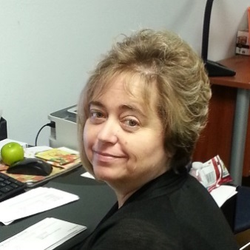
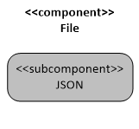


Personas
Shipper&Receiver
Dan is a Sr. Financial Analyst that works in the Finance Department of BigCorp
Receiver
Teresa was hired temporarily by BigCorp to assist the Finance Department with data entry tasks.
JSON Deserializer Service
JavaScript Object Notation (JSON) Deserializer service used to transform JSON data from permanent storage into instantiated objects of the Shipment class.
Interoffice Courier
John works for the supplier courier that has the current contract with BigCorp to provide the interoffice shipping
ADMIN
Dayne is the admin of ShipIT the new software application developed by BigCorp to provide the interoffice shipping.

Slide 16
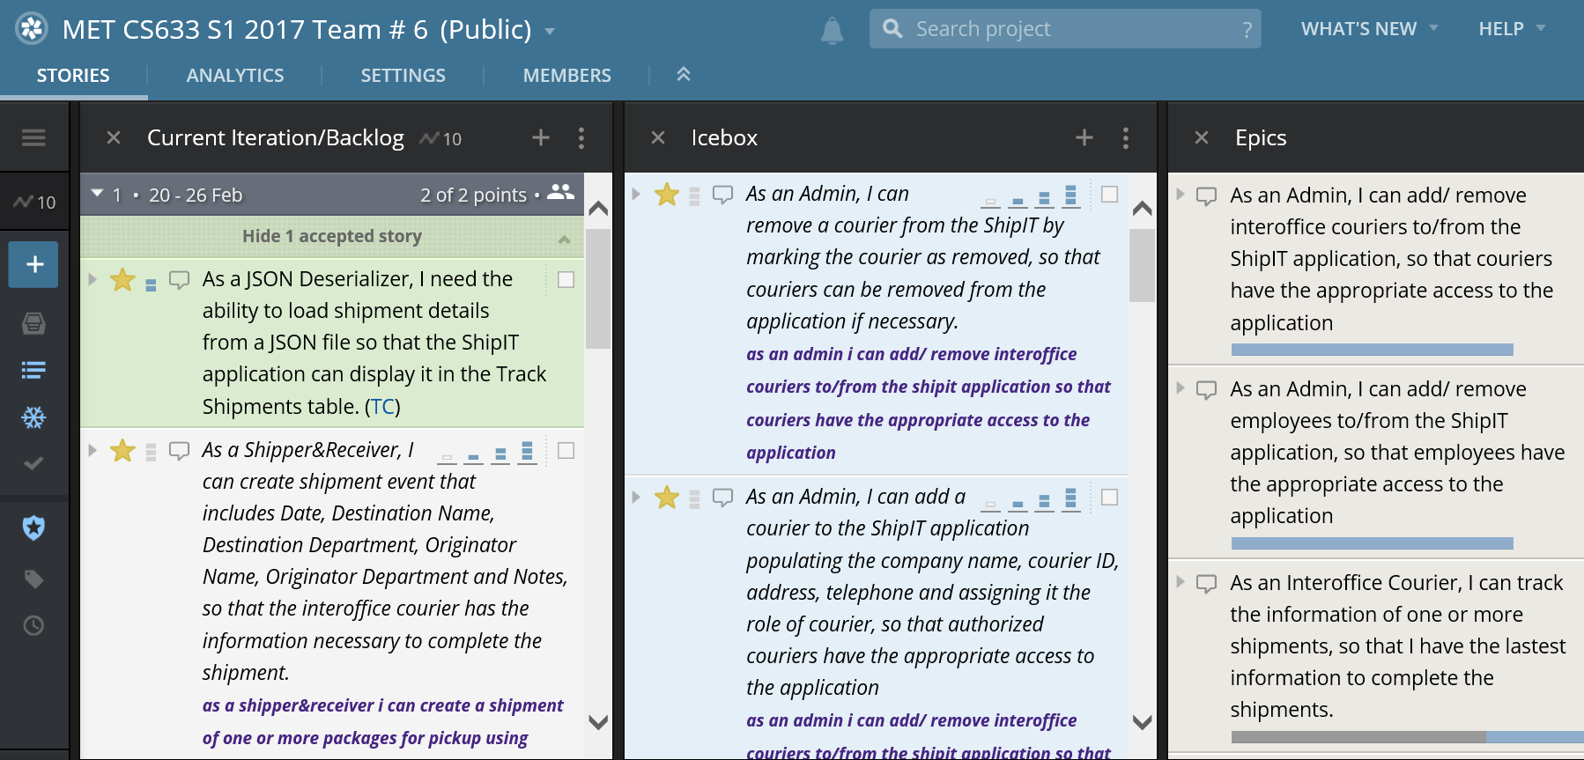
Pivotal Tracker
Link: https://www.pivotaltracker.com/n/projects/1957935#

Slide 17
Requirements (Epics & Stories)
Shipper&Receiver | As a Shipper&Receiver, I can create a shipment of one or more packages for pickup using ShipIT, so that the interoffice courier is informed and completes my shipment.
 | As a Shipper&Receiver, I can create shipment event that includes Date, Destination Name, Destination Department, Originator Name, Originator Department and Notes, so that the interoffice courier has the information necessary to complete the shipment.
 | As a Shipper&Receiver, I can edit/cancel a shipment event, so that corrections can be completed for the interoffice courier to have the most accurate information necessary to complete the shipment.
 | As a Shipper&Receiver, I can track a shipment of one or more packages, so that I have information of the status of my shipment.
 | As a Shipper&Receiver, I can see a list of items in transit that includes tracking #, status, Date shipment was created, Date Delivered, Destination Name, Destination Department, Originator Name and Originator Department so that I have in one place all the information of the status of my shipment.
 | As a Shipper&Receiver, I can select a shipment(s) from a list to print information for selected shipment(s), so that I can have a physical receipt for record keeping or in case a proof is required.

Slide 18
Requirements (Epics & Stories)
Receiver | As a Receiver, I can track a shipment of one or more packages, so that I have information of the status of my shipments.
 | As a Receiver, I can see a list of items in transit that includes tracking #, status, Date shipment was created, Date Delivered, Destination Name, Destination Department, Originator Name and Originator Department so that I have in one place all the information of the status of my shipment.
 | As a Receiver, I can select a shipment(s) from a list to print information for selected shipment(s), so that I can have a physical receipt for record keeping or in case a proof is required.

Slide 19
Requirements (Epics & Stories)
Interoffice Courier | As an Interoffice Courier, I can track the information of one or more shipments, so that I have the latest information to complete the shipments.
 | As an Interoffice Courier, I can see a list of items in transit that includes tracking #, status, Date shipment was created, Date Delivered, Destination Name, Destination Department, Originator Name and Originator Department, so that I have in one place all the information necessary to complete the shipment.
 | As an Interoffice Courier, I can mark a shipment as picked up, so that a status and tracking of the shipment can be updated.
 | As an Interoffice Courier, I can mark a shipment as delivered, so that a status and tracking of the shipment can be updated.

Slide 20

Requirements (Epics & Stories)
Admin | As an Admin, I can add/ remove employees to/from the ShipIT application, so that employees have the appropriate access to the application
 | As an Admin, I can add a BigCorp Employee to the ShipIT application populating his/her name, assigning an ID, populating corresponding Department and role, so that new authorized users have the appropriate access to the application
 | As an Admin, I can remove a BigCorp Employee from the ShipIT by marking the employee as removed, so that users can be removed from the application if necessary.
 | As an Admin, I can add/ remove interoffice couriers to/from the ShipIT application, so that couriers have the appropriate access to the application
 | As an Admin, I can add a courier to the ShipIT application populating the company name, courier ID, address, telephone and assigning it the role of courier, so that authorized couriers have the appropriate access to the application
 | As an Admin, I can remove a courier from the ShipIT by marking the courier as removed, so that couriers can be removed from the application if necessary

Slide 21
Requirements (Epics & Stories)
JSON Deserializer | As a JSON Deserializer, I need the ability to load shipment details from a JSON file so that the ShipIT application can display it in the Track Shipments table.

Slide 22
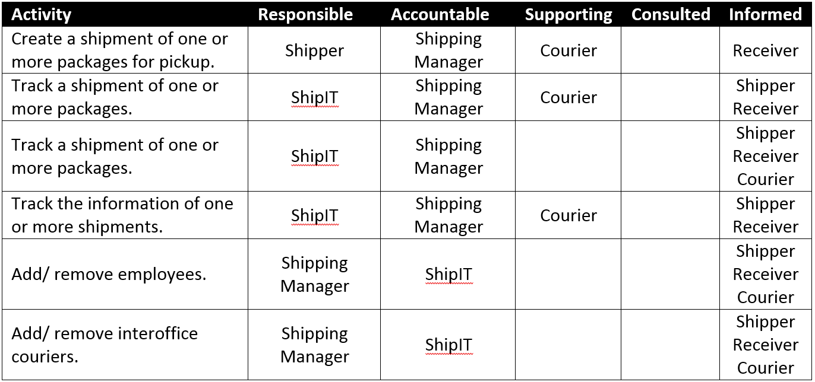
RASCI Chart
ShipIT only supports four roles.
Always had at least one empty cell per activity.
Can be used to determine which roles need which type of access.
Read/Write for Responsible and Accountable.
Read Only for the remainder.

Slide 23
Use Cases
Use Case
Use Case Name | Create a Shipment in ShipIT
Use Case ID | 1
Description | This use case describes the event of a Shipper&Receiver creating a Shipment by entering the destination and the sender information.
Actor | Shipper&Receiver
Preconditions | Shipper&Receiver is Logged into the system
Cross Reference | Story 1.1
Typical Course of Events | Actor Actions | System Response (Optional)
 |  | 1. System displays the Track Shipments Screen
 | 2. Shipper&Receiver Clicks the Create New Shipment Link | 3. System displays the Create Shipment Screen
 | 4. Shipper&Receiver enters Destination Name | 5. System displays entry on Destination Name field
 | 6. Shipper&Receiver enters Destination Department | 7. System displays entry on Destination Department field
 | 8. Shipper&Receiver enters Sender Name | 9. System displays entry on Sender Name field
 | 10. Shipper&Receiver enters Sender Department | 11.System displays entry on Sender Department field
 | 12. Shipper&Receiver enters Notes | 13. System displays entry on Notes field
 | 14. Shipper&Receiver clicks the Submit button | 15. System closes Create Shipment Screen and displays the Track Shipments Screen
Alternate Courses
Alt-Step 14 | Shipper&Receiver clicks the Cancel button | System displays the Track Shipments Screen
Wrap Up
Assumptions | Shipper&Receiver has access to the ShipIT application.
Post Conditions | The shipment has been created.
Remarks

Slide 24
Use Cases
Use Case Name | Edit a Shipment in ShipIT
Use Case ID | 2
Description | This use case describes the event of a Shipper&Receiver editing a shipment by updating the destination and or the sender information.
Actor | Shipper&Receiver
Preconditions | Shipper&Receiver is Logged into the system
Cross Reference | Story 1.2
Typical Course of Events | Actor Actions | System Response (Optional)
 |  | 1. System displays the Track Shipments Screen
 | 2. Shipper&Receiver selects a row or shipment | 3. System highlights selection
 | 4. Shipper&Receiver clicks Edit Selected button | 5. System displays Edit Shipment Screen, displaying existing information
 | 6. Shipper&Receiver updates Destination Name | 7. Systems displays updated entry in Destination Name field
 | 8. Shipper&Receiver clicks the Save | 9. System closes Edit Shipment Screen and displays the Track Shipments Screen
Alternate Courses
Alt-Step 6 | Shipper&Receiver updates Destination Department | Systems displays updated entry in Destination Department field
Alt-Step 6 | Shipper&Receiver updates Sender Name | Systems displays updated entry in Sender Name field
Alt-Step 6 | Shipper&Receiver updates Sender Department | Systems displays updated entry in Sender Department field
Alt-Step 6 | Shipper&Receiver updates Notes | Systems displays updated entry in Notes field
Alt-Step 6 | Shipper&Receiver clicks the Go Back Button | System displays the Track Shipment Screen
Wrap Up
Assumptions | Shipper&Receiver has access to the ShipIT application.
Post Conditions | The shipment has been edited.

Slide 25
Use Cases
Use Case Name | Track a Shipment in ShipIT
Use Case ID | 3
Description | This use case describes the event of a Shipper&Receiver, Receiver or Interoffice Courier tracking a shipment by viewing shipment information.
Actor(s) | Shipper&Receiver, Receiver or Interoffice Courier
Preconditions | Shipper&Receiver, Receiver or Interoffice Courier is Logged into the system
Cross Reference | Stories 2.1 and 3.1
Typical Course of Events | Actor Actions | System Response (Optional)
 |  | 1. System displays the Track Shipments Screen
 | 2. Shipper&Receiver, Receiver or Interoffice Courier views a list of shipments and their tracking information
Alternate Courses
Alt-Step
Wrap Up
Assumptions | Shipper&Receiver, Receiver or Courier have access to the ShipIT application.
Post Conditions | The shipment has been tracked.

Slide 26
Use Cases
Use Case Name | Print a Shipment in ShipIT
Use Case ID | 4
Description | This use case describes the event of a Shipper&Receiver or Receiver selecting and item from the tracking shipment list and requesting the details of the shipment to be printed.
Actor(s) | Shipper&Receiver or Receiver
Preconditions | Shipper&Receiver or Receiver is Logged into the system
Cross Reference | Stories 2.2, 3.2, and 4.1
Typical Course of Events | Actor Actions | System Response (Optional)
 |  | 1. System displays the Track Shipments Screen
 | 2. Shipper&Receiver or Receiver selects a row or shipment | 3. System highlights selection
 | 4. Shipper&Receiver or Receiver selects Print Selected button | 5.System displays the Track Shipments Screen
Alternate Courses
Alt-Step
Wrap Up
Assumptions | Shipper&Receiver or Receiver have access to the ShipIT application.
Post Conditions | The shipment confirmation for shipment selected has been printed.

Slide 27
Use Cases
Use Case Name | Mark a Shipment as Picked Up in ShipIT
Use Case ID | 5
Description | This use case describes the event of an Interoffice Courier marking a shipment as picked up and updating its status.
Actor | Interoffice Courier
Preconditions | Interoffice Courier is Logged into the system
Cross Reference | Story 4.2
Typical Course of Events | Actor Actions | System Response (Optional)
 |  | 1. System displays the Track Shipments Screen
 | 2. Interoffice Courier selects a row or shipment | 3. System highlights selection
 | 4. Interoffice Courier selects Update Status button | 5. System displays the Update Shipment Status screen
 | 6. Interoffice Courier selects Picked Up from the Update Shipment Status drop down list
 | 7. Interoffice Courier clicks the Save button. | 8. System displays the Track Shipments Screen and displays the Status as Picked Up for the updated shipment.
Alternate Courses
Alt-Step | 1. In the Update Shipment Status screen, the Interoffice Courier clicks the Go Back button. | 2. System displays the Track Shipments Screen with no changes made to the shipment status.
Wrap Up
Assumptions | Interoffice Courier has access to the ShipIT application.
Post Conditions | The shipment status has been updated to Picked Up.

Slide 28
Use Cases
Use Case Name | Mark a Shipment as Delivered in ShipIT
Use Case ID | 6
Description | This use case describes the event of an Interoffice Courier marking a shipment as Delivered and updating its status.
Actor | Interoffice Courier
Preconditions | Interoffice Courier is Logged into the system
Cross Reference | Story 4.3
Typical Course of Events | Actor Actions | System Response (Optional)
 |  | 1. System displays the Track Shipments Screen
 | 2. Interoffice Courier selects a row or shipment | 3. System highlights selection
 | 4. Interoffice Courier selects Update Status button | 5. System displays the Update Shipment Status screen
 | 6. Interoffice Courier selects Delivered from the Update Shipment Status drop down list
 | 7. Interoffice Courier clicks the Save button. | 8. System displays the Track Shipments Screen and displays the Status as Delivered for the updated shipment.
Alternate Courses
Alt-Step | 1. In the Update Shipment Status screen, the Interoffice Courier clicks the Go Back button. | 2. System displays the Track Shipments Screen with no changes made to the shipment status.
Wrap Up
Assumptions | Interoffice Courier has access to the ShipIT application.
Post Conditions | The shipment status has been updated to Delivered.

Slide 29
Use Cases
Use Case Name | Add Users to ShipIT
Use Case ID | 7
Description | This use case describes the event of user management by admin.
Actor | Shipping Manager
Preconditions | Shipping Manager is Logged into the system
Cross Reference | Stories 5.1 and 6.1
Typical Course of Events | Actor Actions | System Response (Optional)
 |  | 1. System displays user management screen
 | 2. Admin views a list of employees and clicks add button. | 3. System displays input fields for user information
 | 4. Admin inputs user information and clicks save button | 5. System saves the data and loads refreshed screen
Alternate Courses
Alt-Step
Wrap Up
Assumptions | Shipping manger has access to the ShipIT application.
Post Conditions | New employee information has been added to the user list.
Remarks | In the above use case, the term user may refer to either an employee or to an interoffice courier.

Slide 30
Use Cases
Use Case Name | Remove Users from ShipIT
Use Case ID | 8
Description | This use case describes the event of user management by admin.
Actor | Shipping Manager
Preconditions | Shipping Manager is Logged into the system
Cross Reference | Stories 5.2 and 6.2
Typical Course of Events | Actor Actions | System Response (Optional)
 |  | 1. System displays user management screen
 | 2. Admin views a list of employees and select a record to remove | 3. System highlights selection
 | 4. Admin clicks remove button | 5. System removes the data and loads refreshed screen
Alternate Courses
Alt-Step
Wrap Up
Assumptions | Shipping manger has access to the ShipIT application.
Post Conditions | Selected employee information has been removed from the user list.

Slide 31

Product Information

Slide 32
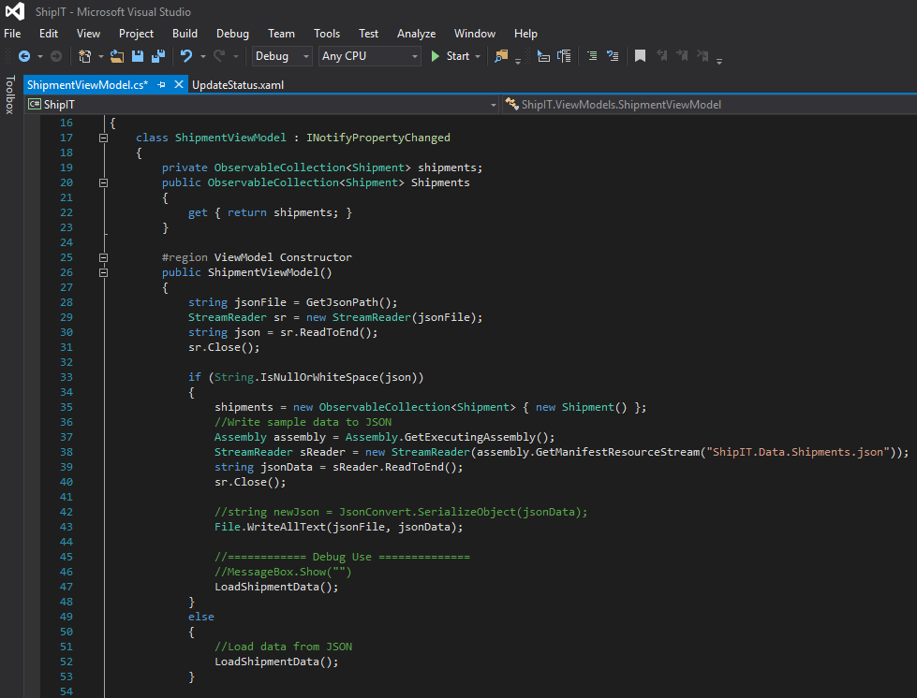
Development Environment
Visual Studio 2015 IDE
Git/GitHub for Source Control
Languages
C# for Business Logic
Extensible Application Markup Language (XAML) for UI
JavaScript Object Notation (JSON) for Data Storage

Slide 33
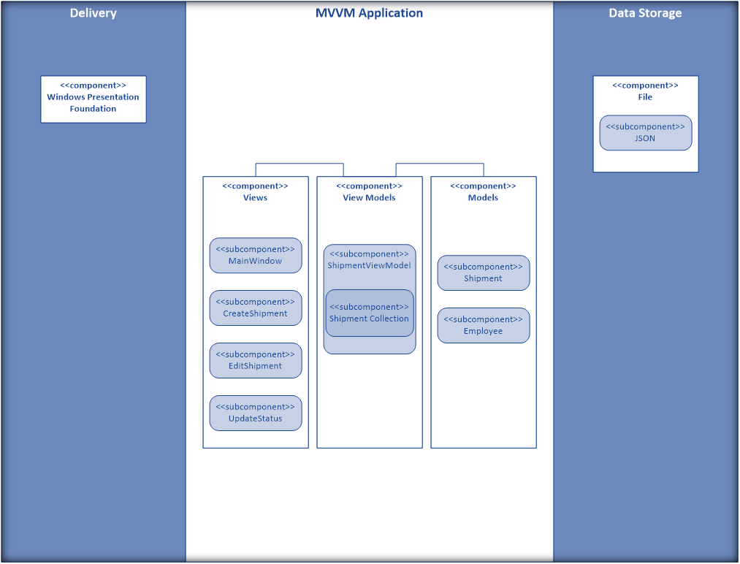
Components Interaction Diagram
Persistent Storage where App Data Resides
Desktop App Presentation Technology
Software Architectural Pattern- MVVM

Slide 34
State Transitions
Four larger boxes represent forms
Events from forms can be triggered from any state
Arrows represent events that trigger state transitions
Inner boxes represent states

Slide 35
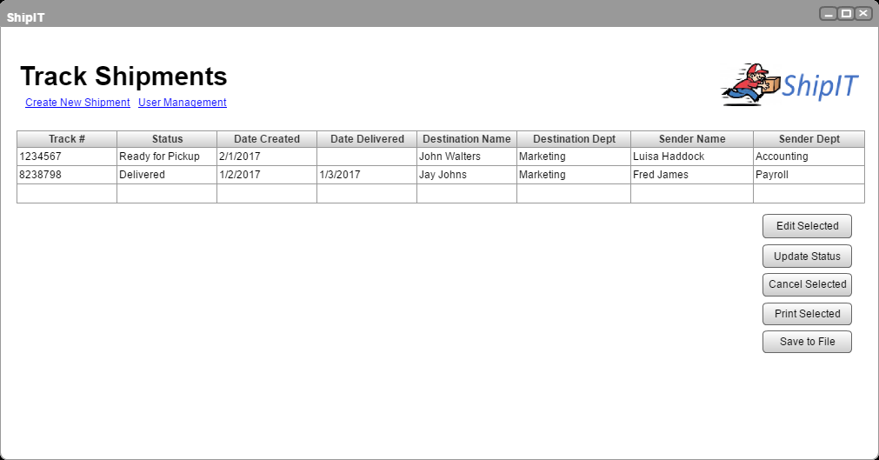
Wireframes

Slide 36
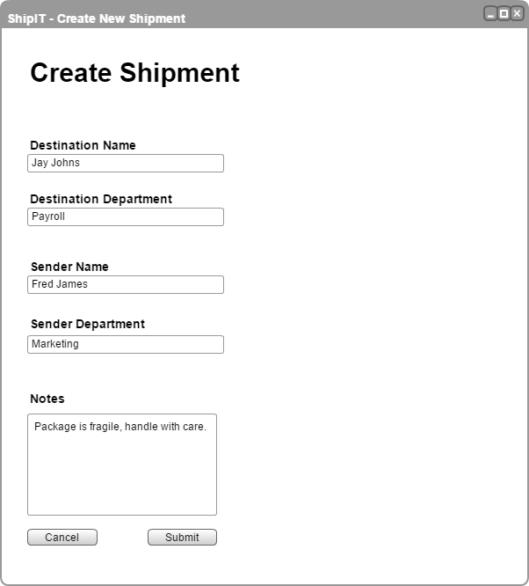
Wireframes

Slide 37
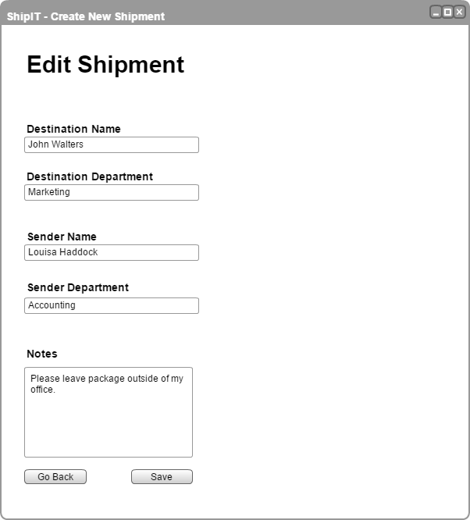
Wireframes

Slide 38
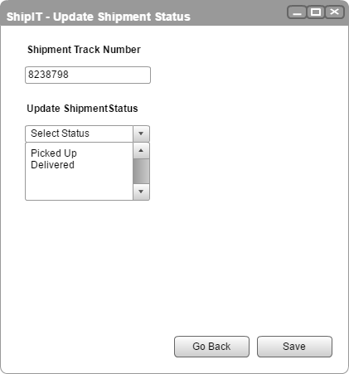
Wireframes

Slide 39
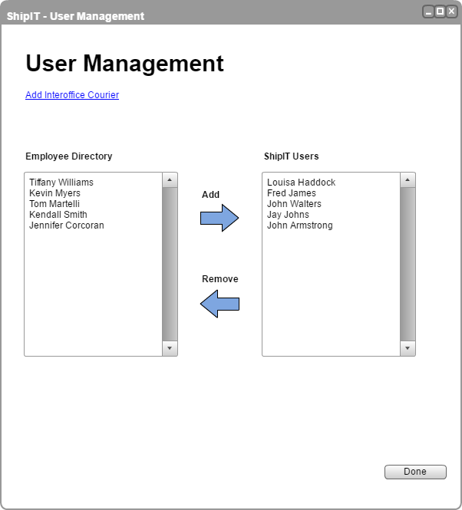
Wireframes

Slide 40
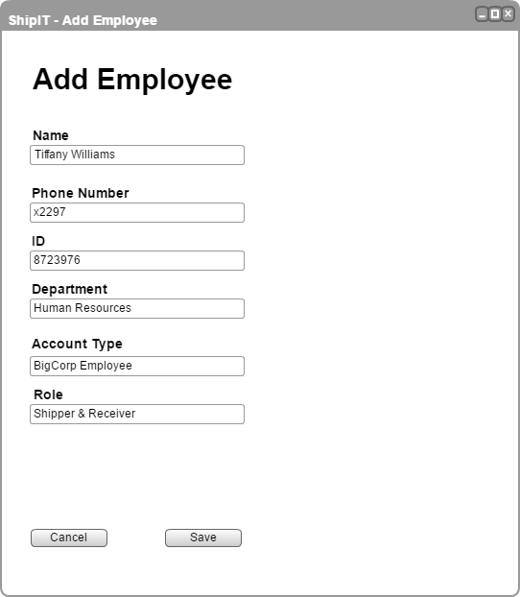
Wireframes

Slide 41
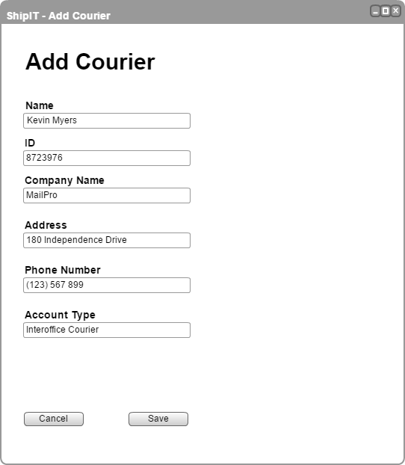
Wireframes

Slide 42
Test Cases
No. | Title | Description | Result
1 | A User Can Create a Shipment | Verify that a shipper&receiver user can create a shipment of one or more packages for pickup. | Pass
2 | Edit/Cancel a Shipment | Verify that a shipper&receiver user can edit and cancel a shipment of one or more packages. | Pass
3 | Shipper&Receiver or Receiver Can View Shipment Information | Verify that a shipper&receiver or receiver user can see the latest information of shipments. | -
4 | Courier Can View & Update Status | Verify that a courier user has access to the list of shipments and update status screen. | Fail
5 | Admin can Add/Remove Employee Information | Verify that an admin user can add or remove employees’ information and the data is saved. | -
6 | Admin can Add/Remove Interoffice Courier Information | Verify that an admin user can add or remove interoffice courier information. | -

Slide 43
Allpairs Results
Role | Activity | Entries
Shipper/Receiver | Track Shipments | Valid
Courier | Track Shipments | Invalid
Shipper/Receiver | Create a Shipment | Invalid
Courier | Create a Shipment | Valid
Receiver | Edit a Shipment | Valid
Admin | Edit a Shipment | Invalid
Receiver | Update Status | Invalid
Admin | Update Status | Valid
Shipper/Receiver | Cancel a Shipment | Valid
Courier | Cancel a Shipment | Invalid
Shipper/Receiver | Print a Shipment | Invalid
Courier | Print a Shipment | Valid
Receiver | Save Data | Valid
Admin | Save Data | Invalid
Receiver | Employee Management | Invalid
Admin | Employee Management | Valid
Shipper/Receiver | Courier Management | Valid
Courier | Courier Management | Invalid
Receiver | Track Shipments | ~Valid
Admin | Track Shipments | ~Invalid
Role | Activity | Entries
Receiver | Create a Shipment | ~Invalid
Admin | Create a Shipment | ~Valid
Shipper/Receiver | Edit a Shipment | ~Invalid
Courier | Edit a Shipment | ~Valid
Shipper/Receiver | Update Status | ~Valid
Courier | Update Status | ~Invalid
Receiver | Cancel a Shipment | ~Valid
Admin | Cancel a Shipment | ~Invalid
Receiver | Print a Shipment | ~Invalid
Admin | Print a Shipment | ~Valid
Shipper/Receiver | Save Data | ~Invalid
Courier | Save Data | ~Valid
Shipper/Receiver | Employee Management | ~Valid
Courier | Employee Management | ~Invalid
Receiver | Courier Management | ~Valid
Admin | Courier Management | ~Invalid
(~) are entries that do not matter because all of the pairings
needed to satisfy the test criteria have already been done.

Slide 44
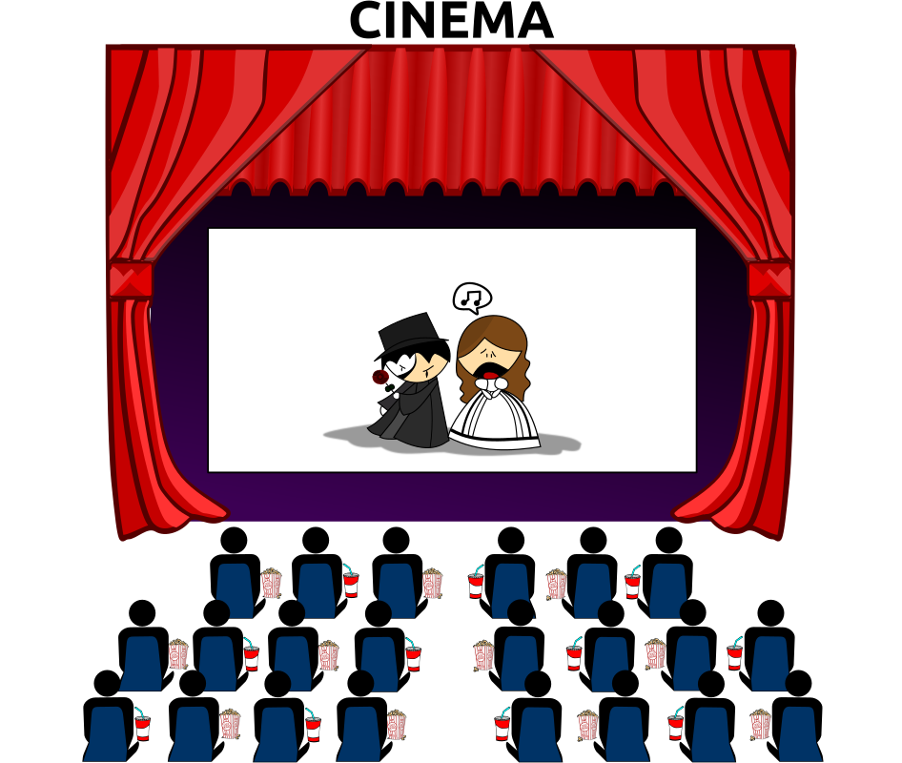
Product Demonstration

Slide 45
Lessons Learned
We kicked off the project ahead of class modules that covered specific techniques such as unit testing.
Due to our 6 week class, we could not work in 2 week sprints like a traditional Agile team.
What didn’t go well:
Our Test Expert located in different time zone. Getting the team together at the same time was a challenge.
We faced a learning curve when using tools: Pivotal Tracker, GitHub
Our developer needed to do extensive research and self-learning to complete coding

Slide 46
Lessons Learned
What went well:
Team communicated frequently through Google Hangouts
Team members jumped into roles according to their strengths
Splitting up work was easy, everyone pitched in on the deliverables.
Maintained a positive attitude throughout.

Slide 47

Questions

